Slide 1
Big Mountain Resort
Guided Capstone Project

Slide 2
Problem Identification
The purpose is to come up with a pricing model for ski resort tickets in the market segment. Big Mountain suspects it may not be maximizing its returns, relative to its position in the market. Build a predictive model for ticket price based on a number of facilities, or properties, boasted by resorts. This will be used to provide guidance for Big Mountain’s pricing and future facility investment plans

Slide 3
Key Findings - Scenario 1: Close up to 10 of the least used runs. - Scenario 2: Adding a run, increasing vertical drop by 150 feet and installing chair lift - Scenario 3: In addition to scenario 2, but adding 2 acres of snow making -Scenario 4: Increasing the longest run by 0.2 miles and guaranteeing its now coverage by adding 4 acres of snow making capabilities
Recommendation
Increasing the vertical drop by 150 feet by adding another run and installing chair lift
This increase the ticket price by $10.10 and the over the season the expected amount will be 17677790

Slide 4
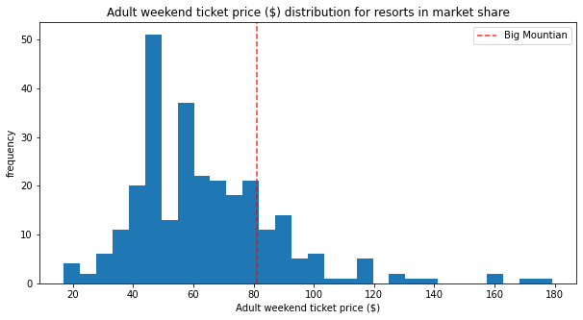
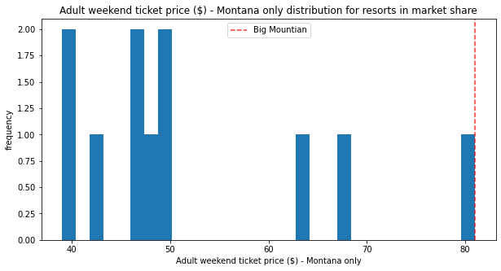
Ticket Price
Big mountain sits overall amongst all resorts for price and for just other resorts in Montana

Slide 5
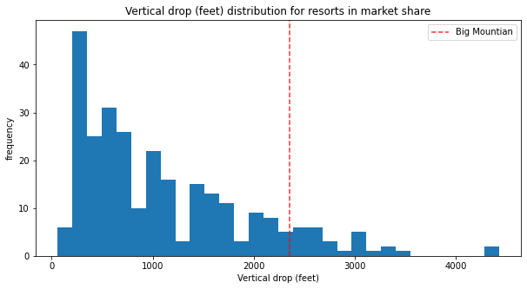
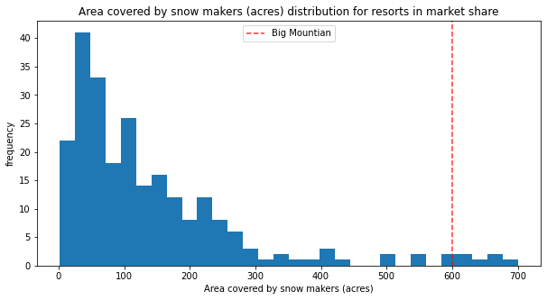
Vertical Drop
Big Mountain is doing well for vertical drop, but there are still quite a few resorts with a greater drop
Snow Making Area
Big Mountain is very high up the league table of snow making area

Slide 6
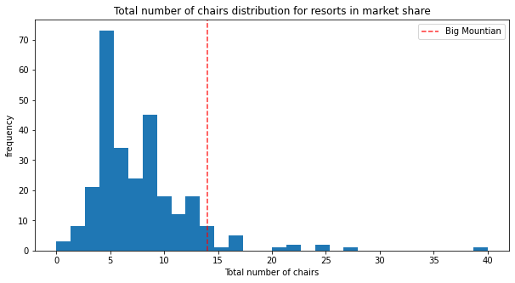
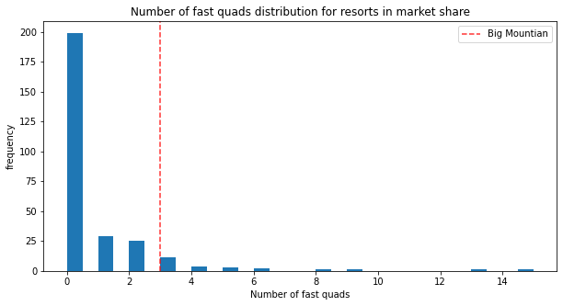
Total Number of Chairs
Big Mountain has amongst the highest number of total chairs, resorts with more appear to be outliers
Fast Quads
Most resorts have no fast quads. Big Mountain has 3, which puts it high up that league table. There are some values much higher, but they are rare.

Slide 7
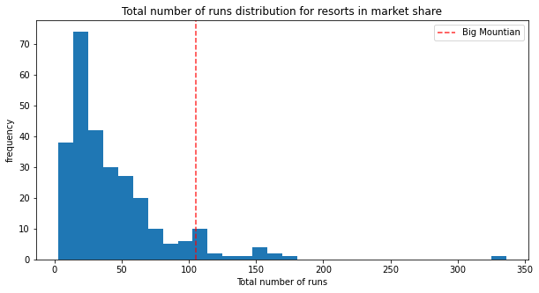
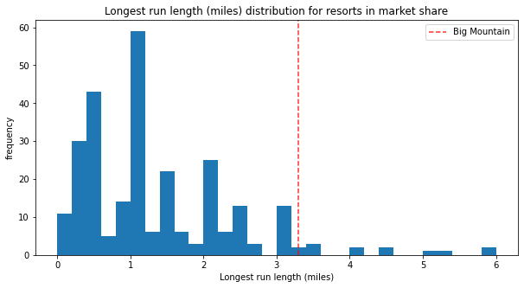
Runs
Big Mountain compares well for the number of runs. There are some resorts with more, but not many.
Longest Run
Big Mountain has one of the longest runs. Although it is just over half the length of the longest, the longer ones are rare.

Slide 8
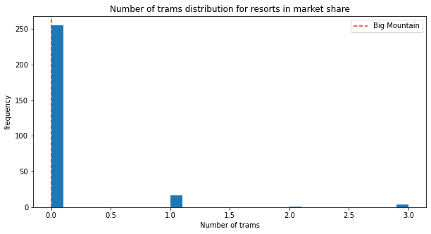
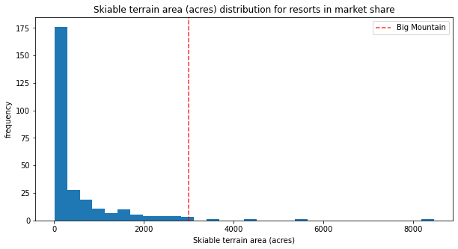
Trams
The vast majority of resorts, such as Big Mountain, have no trams.
Skiable Terrain Area
Big Mountain is amongst the resorts with the largest amount of skiable terrain.

Slide 9
Summary and Conclusion
Big Mountain ranks the top resorts in
Skiable Terrain
Runs
Number of chairs
Snow making capacity
The logical direction is to go with scenario 2 to increase revenue by adding another run and increasing the vertical drop by 150 feet. This would increase ticket price by $10.10 and over the season the expected amount is $176777909. Even though adding 2 acres makes a little difference here, we can probably add more than 2 acres to make it more of an impact.

